Slide 1
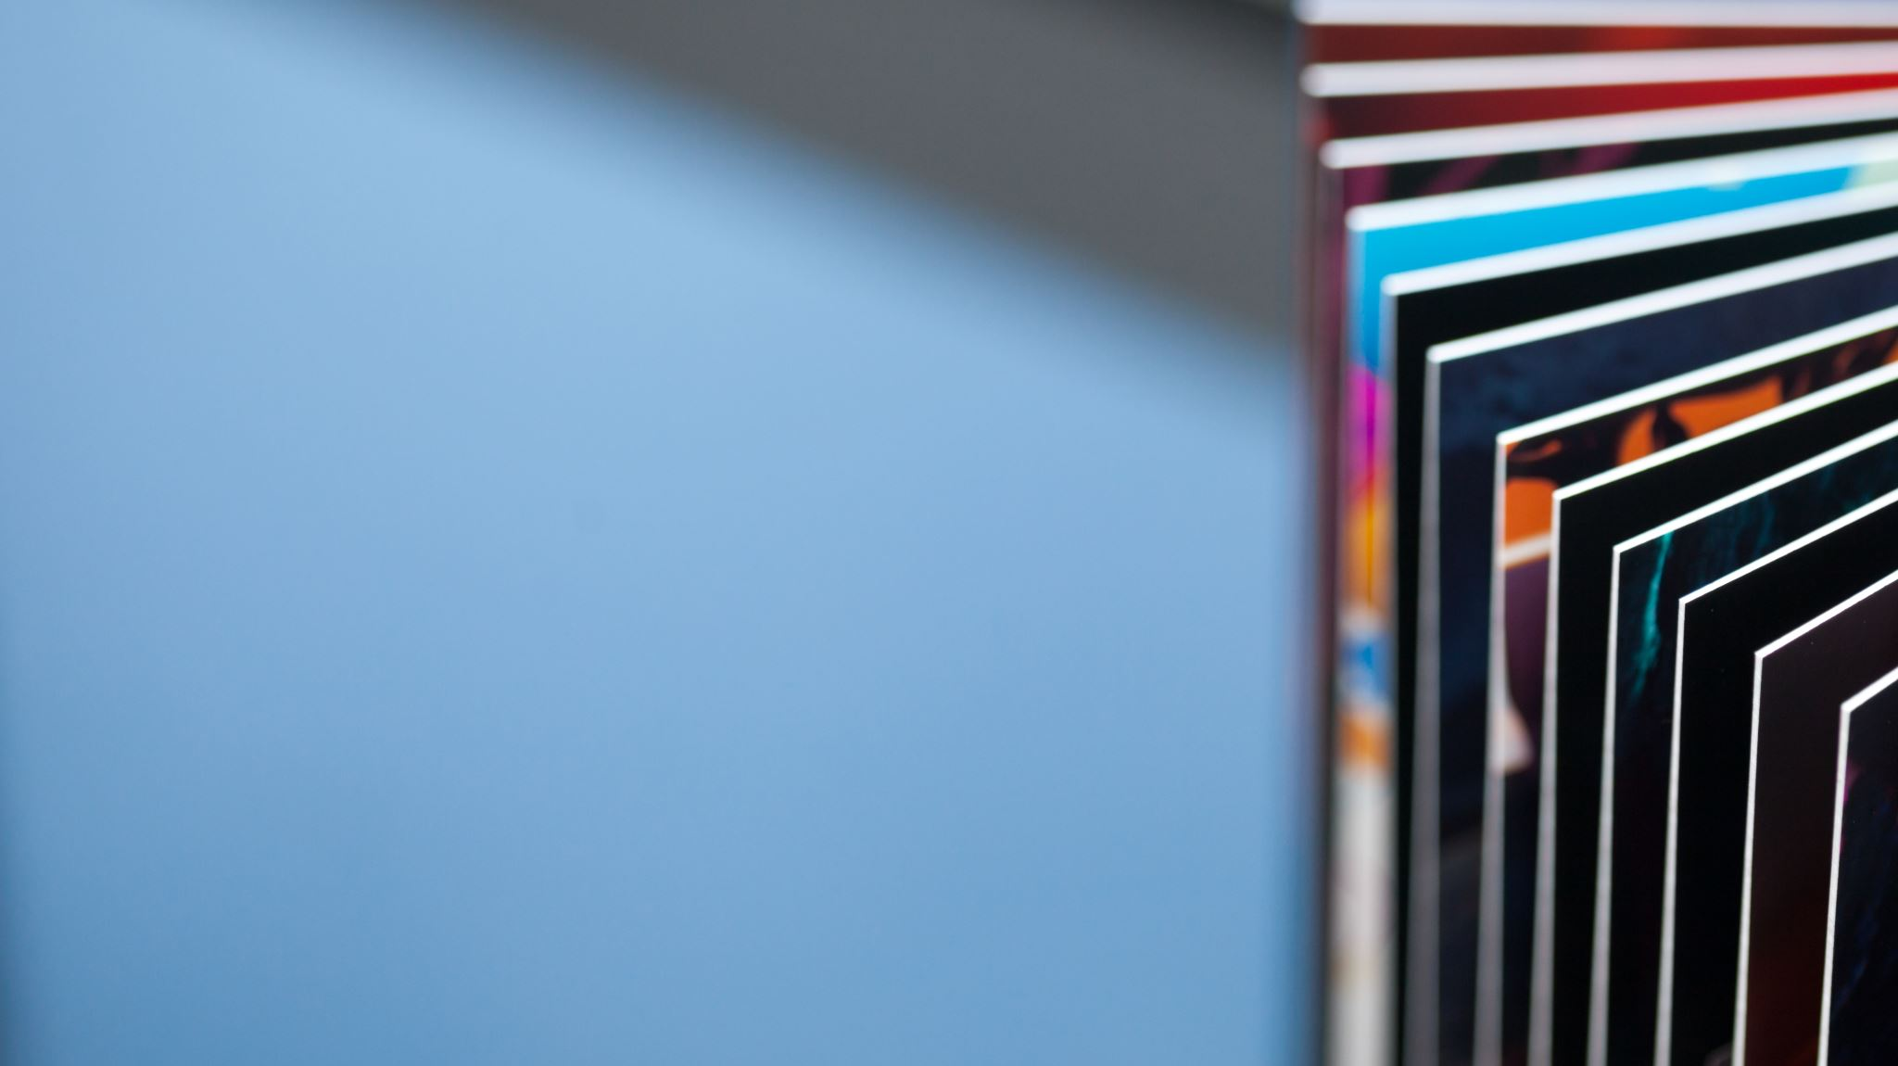
ASYMPTOTIC NOTATIONS
Martzel P. Baste

Slide 2

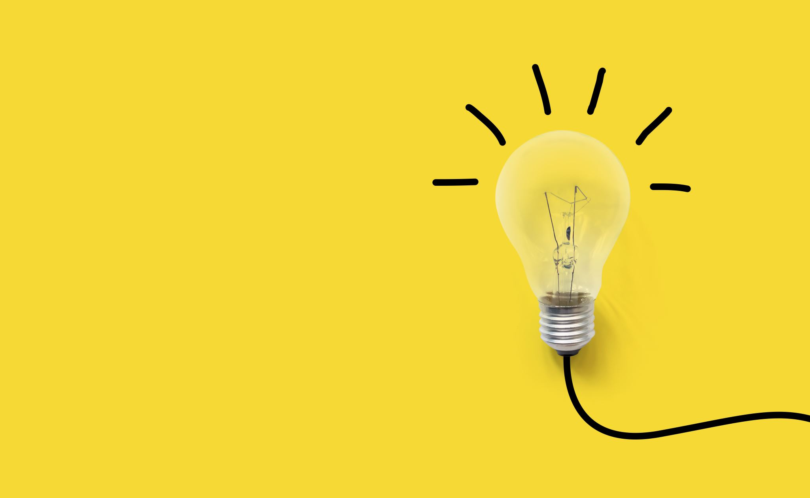
Intended Learning outcomes
Explore the three Asymptotic Notations
Calculating the complexity based on Asymptotic Notations

Slide 3
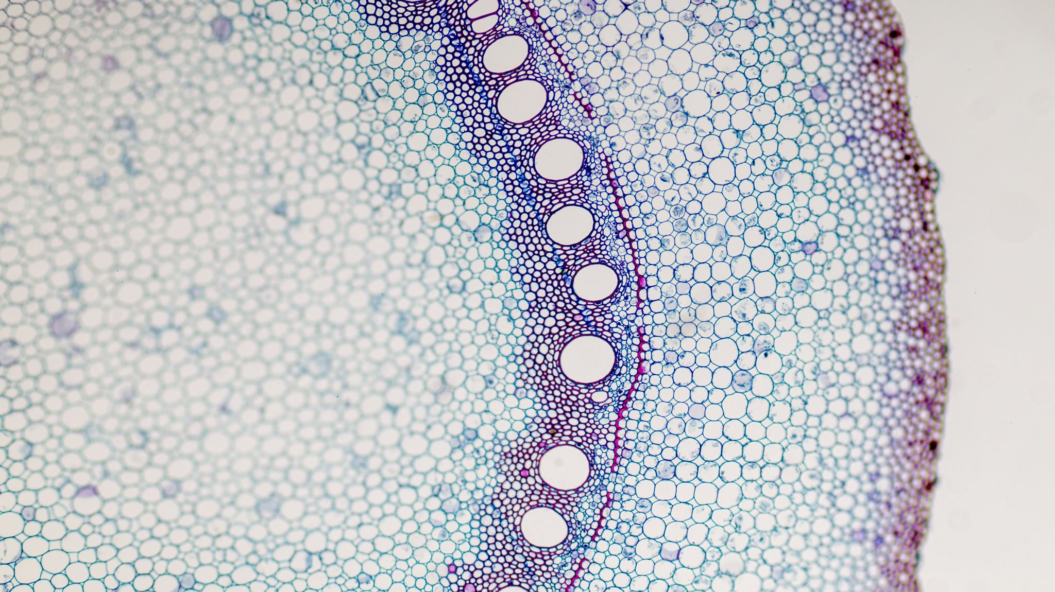
asymptotic notations
Θ Notation (theta)
Big-O Notation
Ω Notation
(Omega)

Slide 4

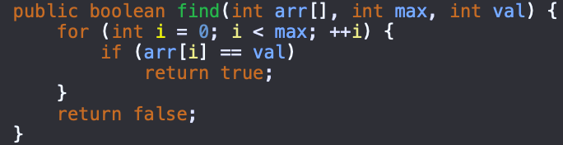




























Best case
Average case
Worst case

Slide 5
Big Oh denotes "fewer than or the same as" <expression> iterations.
Big Omega denotes "more than or the same as" <expression> iterations.
Big Theta denotes "the same as" <expression> iterations.
Little Oh denotes "fewer than" <expression> iterations.
Little Omega denotes "more than" <expression> iterations.
Maximum (Upper): Worst
Minimum (Lower): Best
Average Bound
Types of Notations for Time Complexity

Slide 6












Slide 7
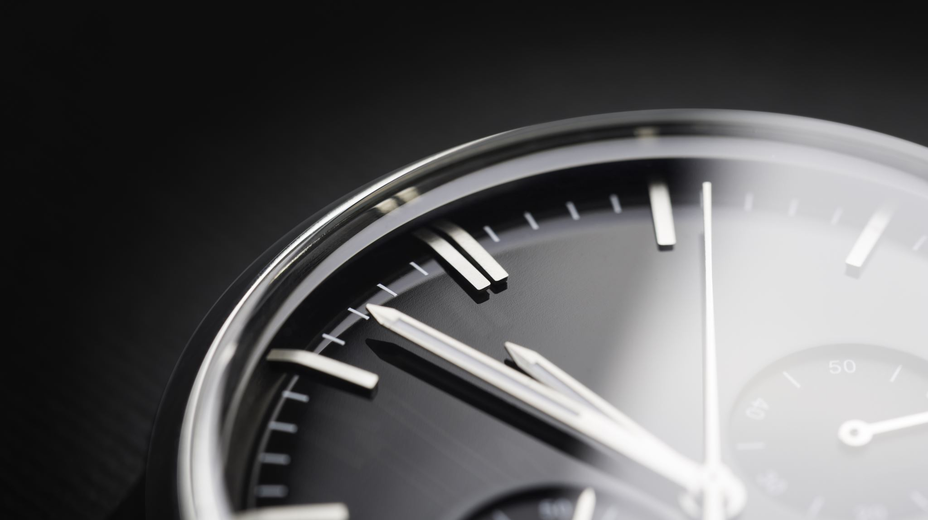
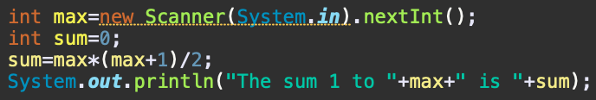
Calculating Time Complexity
Constant O(1)
The time complexity of algorithms is most commonly expressed using the big O notation. It's an asymptotic notation to represent the time complexity

Slide 8
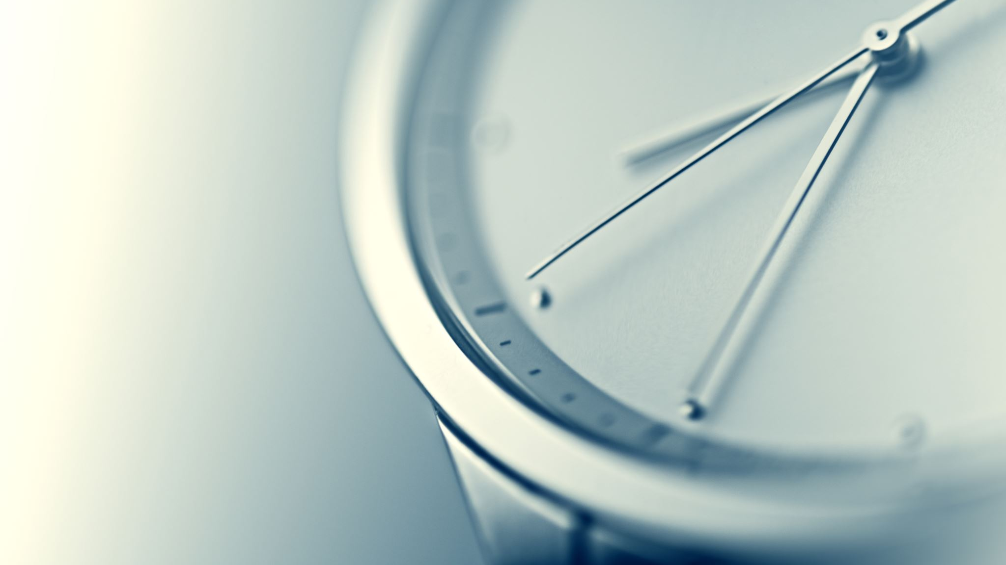
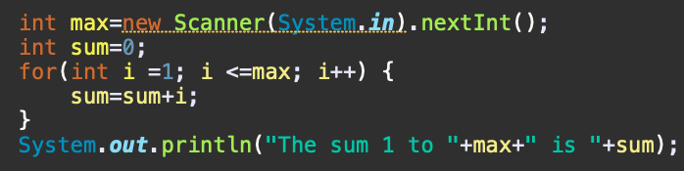
Calculating Time Complexity
Constant O(N)
The time complexity for the above algorithm will be Linear. The running time of the loop is directly proportional to N. When N doubles, so does the running time.

Slide 9
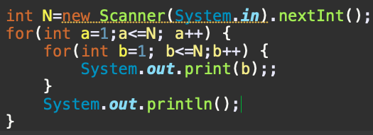







Calculating Time Complexity
QUADRATIC O(N²)
This time, the time complexity for the above code will be Quadratic. The running time of the two loops is proportional to the square of N. When N doubles, the running time increases by N * N.

Slide 10
Calculating Time Complexity - other
Logarithmic Time Complexity
linear and logarithmic

Slide 11
Summary
Best case. Find at first position: 1 compare
Worst case. Find at last position: N compares
Average case. [(n + 1)/2 compares]
There are mainly three asymptotic notations:
  Big-O notation (Worst)
  Omega notation (Best)
  Theta notation (Average)
Complexity and running time are often expressed in "Big O notation," which is used to describe the approximate amount of time an algorithm requires to complete, based the size of its input.
O(1), O(N), O(LogN), O(N²), O(2^{N}) are the most commonly used Big-O

Slide 12

THANK YOU

